Slide 1
Exercise 6:
Photosynthesis
Use this PPT to help you complete Exercise #6 Summary Sheet.

Slide 2
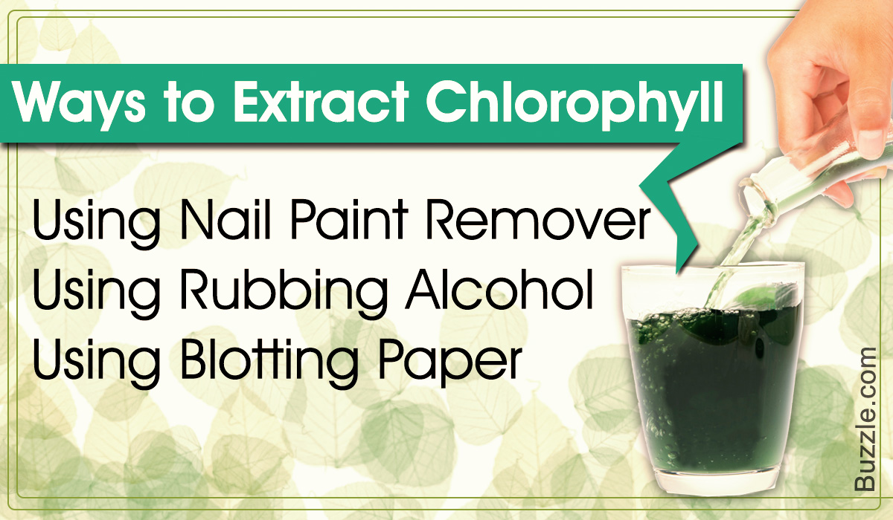
Chlorophyll extraction from spinach
Chlorophyll is the green pigment in plants that helps with photosynthesis
(OPTIONAL) You could do this at home if you want:
  Steam/boil broccoli, kale or spinach and you will notice the water turns green because of the chlorophyll
  OR use rubbing alcohol or nail polish remover (https://biologywise.com/how-to-extract-chlorophyll)

Slide 3
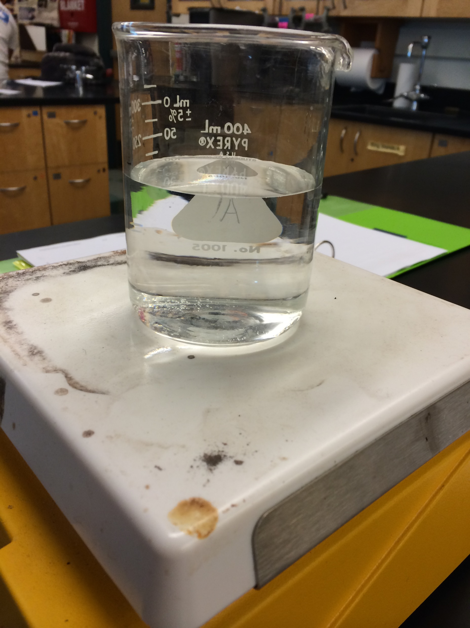
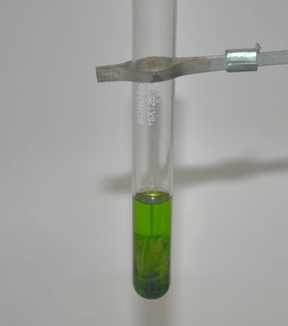
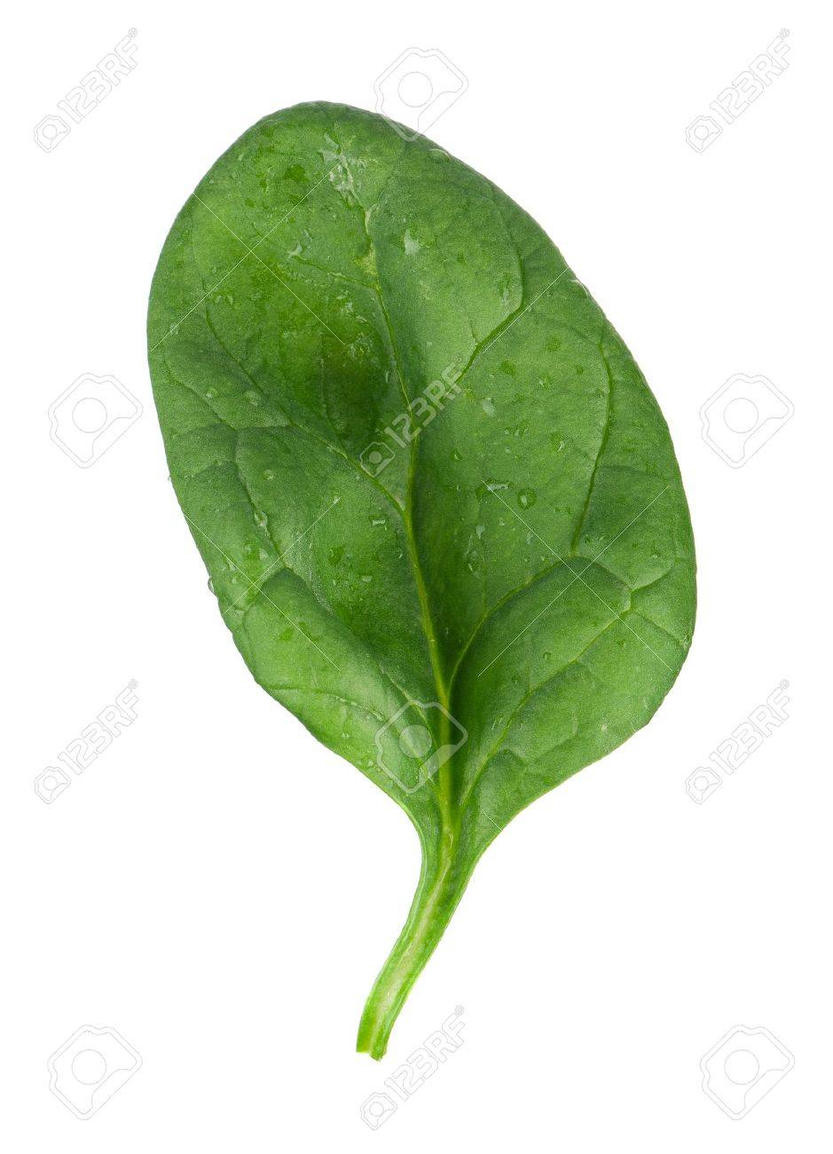
Chlorophyll extraction from spinach
In our lab exercise, to extract chlorophyll from spinach, all you need is ethanol and some heat. The chlorophyll dissolves into the ethanol.
+
But is there enough chlorophyll in here to run our experiments?
Hot ethanol

Slide 4
Chlorophyll extraction from spinach
%Transmittance is a measure of how much light passes through a solution
Sample must have a %Transmittance between 65%-85% to be usable
%T = 40%
Too concentrated
How would you adjust this sample?
%T = 90%
Too dilute
How would you adjust this sample?
%T = 68%
This sample is usable!!
Dilute with more ethanol
Heat leaf to extract more chlorophyll

Slide 5
Light absorbance of chlorophyll
With a usable sample, we now measure the light absorption of chlorophyll at different wavelengths (colors)
  The wavelengths absorbed help stimulate photosynthesis
  The wavelengths reflected are not useful for stimulating photosynthesis
REVIEW: A green colored plant should absorb which color(s)? A green colored plant should reflect which color(s)?

Slide 6
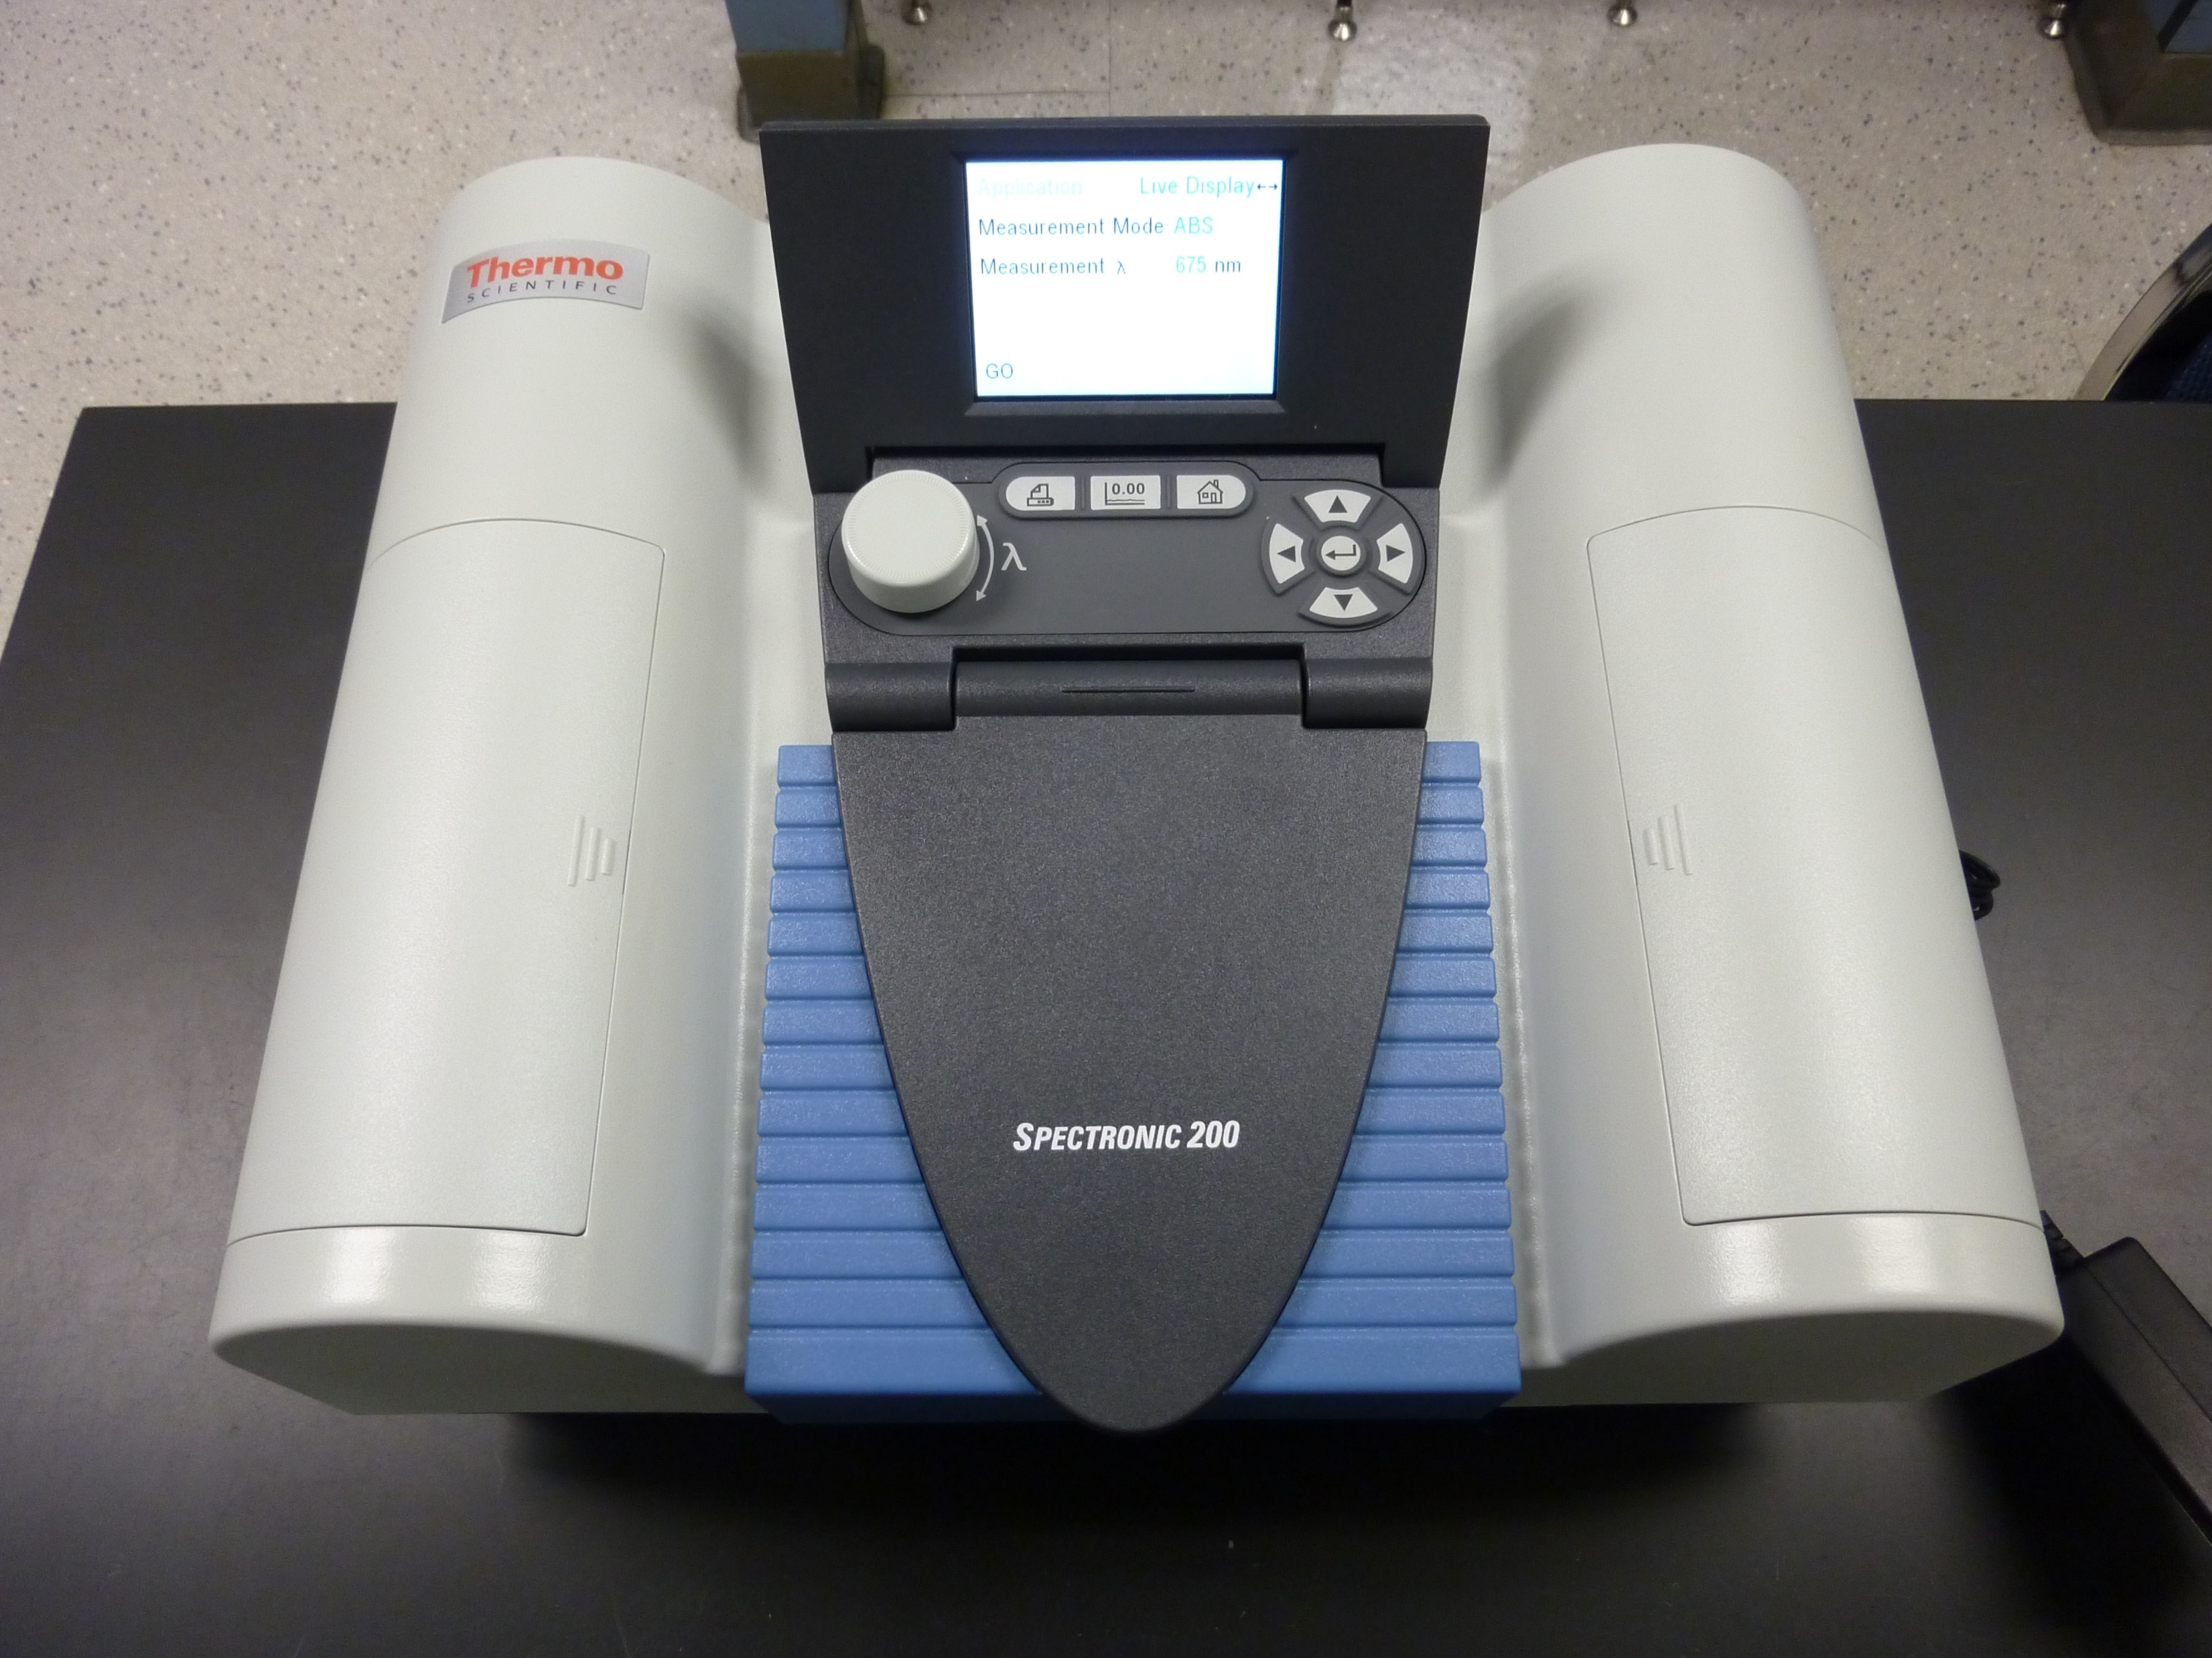
Light absorbance of chlorophyll
Chlorophyll sample
Ethanol
Don’t forget to blank/zero your sample!

Slide 7
Use this data and graph (on next slide) to answer Questions 1-3
WAVELENGTH (nm) | COLOR OF LIGHT AT THIS WAVELENGTH | ABSORBANCE
400 | Violet | 0.8
425 | Blue/Violet | 1.09
450 | Blue | 0.98
475 | Blue | 0.53
500 | Blue/Green | 0.1
525 | Green | 0.08
550 | Green/Yellow | 0.12
575 | Yellow | 0.18
600 | Yellow/Orange | 0.24
625 | Orange | 0.6
650 | Red | 0.8
675 | Red | 0.2

Slide 8
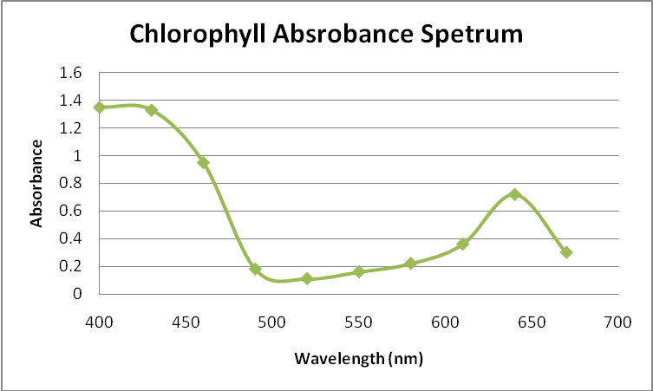
Use this data and graph (on next slide) to answer Questions 1-3

Slide 9
Light intensity and photosynthesis
How does distance from light affect rate of photosynthesis?
6CO₂ +6H₂O → C₆H₁₂O₆ + 6O₂
We measure rate of photosynthesis by seeing how much oxygen is produced by an Elodea plant
CO₂ and H₂O are provided by adding NaHCO₃ solution
Light is provided by light bulb

Slide 10
Light intensity and photosynthesis
Check out video below to see a demo of the experiment that we would have done in class. The distances used are different than our protocol, but the procedure, equipment and concepts are similar.
https://www.youtube.com/watch?v=dvOvLLAa_cc
Then use the slides that follow to help input data into your summary sheet.

Slide 11
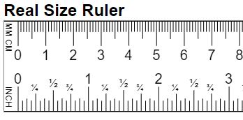
Light intensity and photosynthesis
See Figure 6.3 (p.56 of lab manual) for experimental set-up
Start both the control (only NaHCO₃) and experimental tube (Elodea and NaHCO₃) at 0.2ml on measuring pipette
Take measurements of tubes below at 25cm from light and record in Table 6.3 on summary sheet (40cm data provided on summary sheet)
Elodea
Time = 0
Minutes → | 0 | 5 | 10 | 15 | 20
Elodea (ml) | 0.2
Control (ml) | 0.2
Elodea – Control (graphing data) | 0ml
0.1 0.2 0.3 0.4 0.5 0.6 0.7 0.8
Control
These are gas bubbles that are produced by the samples

Slide 12
Light intensity and photosynthesis
Time = 5 minutes
Minutes → | 0 | 5 | 10 | 15 | 20
Elodea (ml) | 0.2
Control (ml) | 0.2
Elodea – Control (graphing data) | 0ml
Elodea
0.1 0.2 0.3 0.4 0.5 0.6 0.7 0.8
Control

Slide 13
Light intensity and photosynthesis
Time = 10 minutes
Minutes → | 0 | 5 | 10 | 15 | 20
Elodea (ml) | 0.2
Control (ml) | 0.2
Elodea – Control (graphing data) | 0ml
Elodea
0.1 0.2 0.3 0.4 0.5 0.6 0.7 0.8
Control

Slide 14
Light intensity and photosynthesis
Time = 15 minutes
Minutes → | 0 | 5 | 10 | 15 | 20
Elodea (ml) | 0.2
Control (ml) | 0.2
Elodea – Control (graphing data) | 0ml
Elodea
0.1 0.2 0.3 0.4 0.5 0.6 0.7 0.8
Control

Slide 15
Light intensity and photosynthesis
Time = 20 minutes
Minutes → | 0 | 5 | 10 | 15 | 20
Elodea (ml) | 0.2
Control (ml) | 0.2
Elodea – Control (graphing data) | 0ml
Elodea
0.1 0.2 0.3 0.4 0.5 0.6 0.7 0.8
Control

Slide 16
Light intensity and photosynthesis
Minutes → | 0 | 5 | 10 | 15 | 20
Elodea (ml) | 0.2
Control (ml) | 0.2
Elodea – Control (graphing data) | 0ml
Why does the last row of the data table ask you to subtract the Control from the Elodea sample?

Slide 17
Light intensity and photosynthesis
The CONTROL tube shows the effects of the CO₂ that is produced by the NaHCO₃ added to the tube
The Elodea tube shows the effects of the CO₂ from the NaHCO₃ AND the O₂ produced by the plant
We are only interested in the O₂, so we subtract out the CONTROL (or the amount of CO₂ in the tube) to obtain amount of O₂ produced.
Elodea
O₂ + CO₂
Summary Questions 5-6
0.1 0.2 0.3 0.4 0.5 0.6 0.7 0.8
Control
CO₂

Slide 18
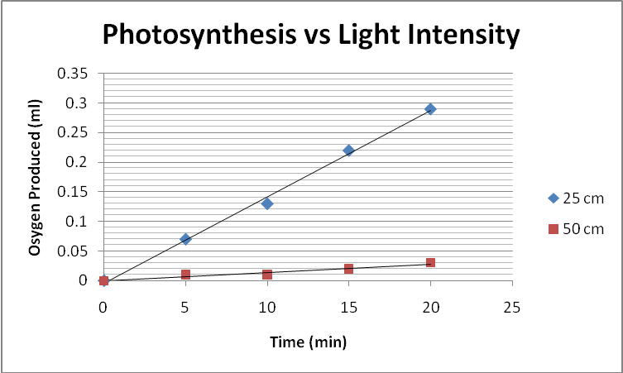
Light intensity and photosynthesis
40 cm
Use this graph to help answer Summary Question 7

Slide 19
Chemical Equation of Photosynthesis
6CO₂ +6H₂O → C₆H₁₂O₆ + 6O₂
Use the equation above and information from your lab manual or textbook to help answer question 8 on your summary sheet

Slide 20
Additional Resources
To watch a video of “Chlorophyll Extraction from Leaves” that is similar to what we do in lab, go to:
https://www.youtube.com/watch?v=gwRjfcet0dk
To watch a video of a “Light Intensity and Rate of Photosynthesis” experiment that is similar to what we do in lab, go to:
https://www.youtube.com/watch?v=WOgquLx4JLo

